Slide 1
Contact Program: Prototype
By: Abir Faisal, William Herrin, Chris Buruchian, and Alexander Truong-Mai.

Slide 2
Team Members Roles:
Abir Faisal:
Create Java FX Modules, Translated XML to Java, Code methods to program, Code & Handle security
William Herrin:
Create Java FX Modules, Translated XML to Java, Code methods to program, Create UMI’s
Chris Buruchian:
Create Java FX Modules, Translated XML to Java, Code methods to program, Code & Handle database
Alexander Truong-Mai:
Create Java FX Modules, Translated XML to Java, Code methods to program, Create UMI’s

Slide 3
Contact Program

Slide 4
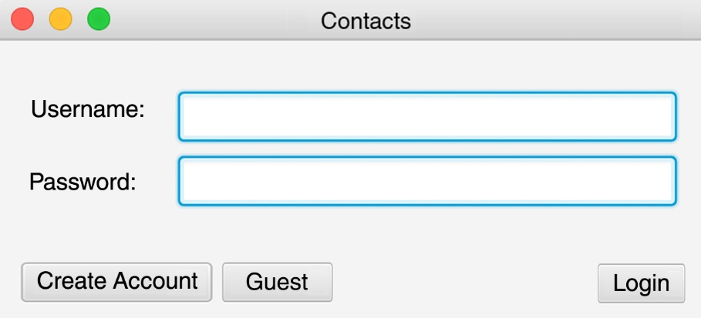
Login Screen
When the user opens program, it is greeted with a login screen. The user has the ability to create its own account or continue as a guest.
If the user already as an account, it is allowed to login in with its own personal username and password.

Slide 5
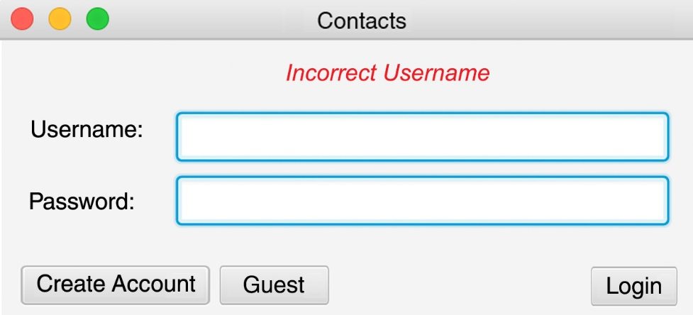

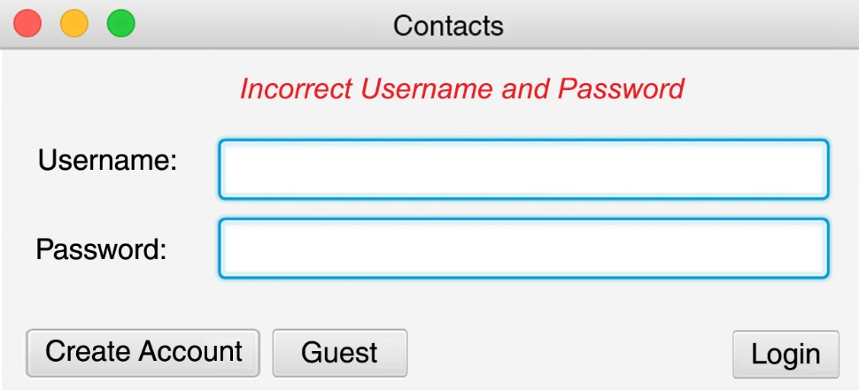
Login: Logging into an account error message.
If a user enters in an incorrect username, password or both. They will receiver one of the follow three error messages.

Slide 6
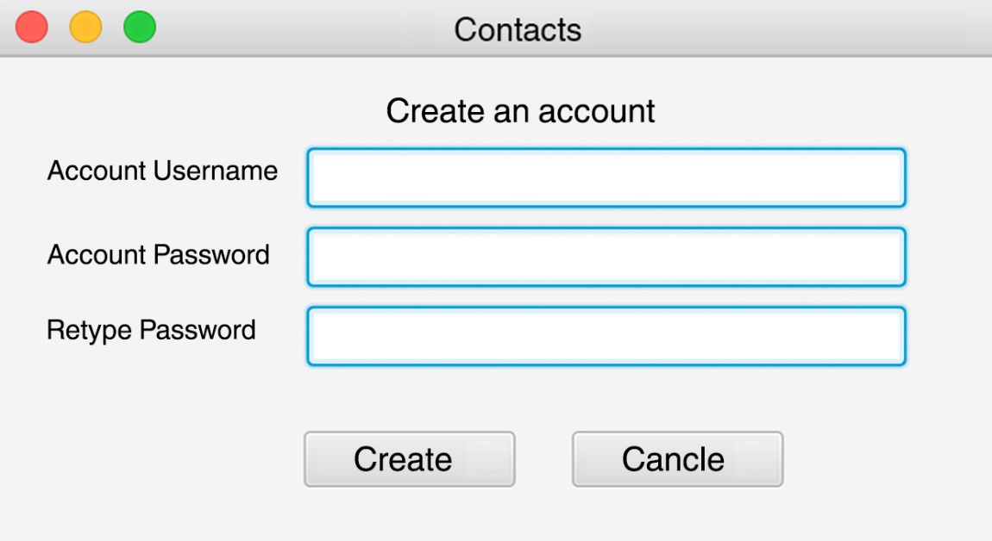
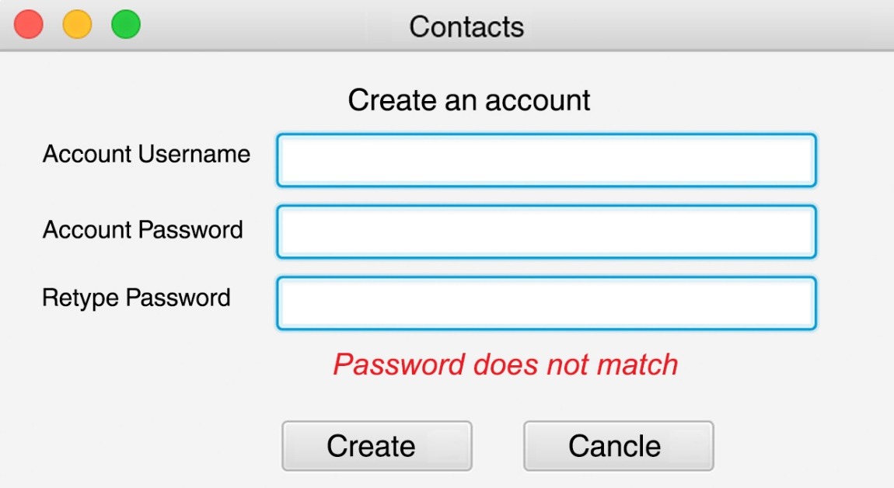
Creating an account
If user decides to create an account it is asked to enter in a username, and password. And user has to retype the same password.
If user did not match the password than an error will appear and is not allowed to continue to create an account until it is matched.

Slide 7
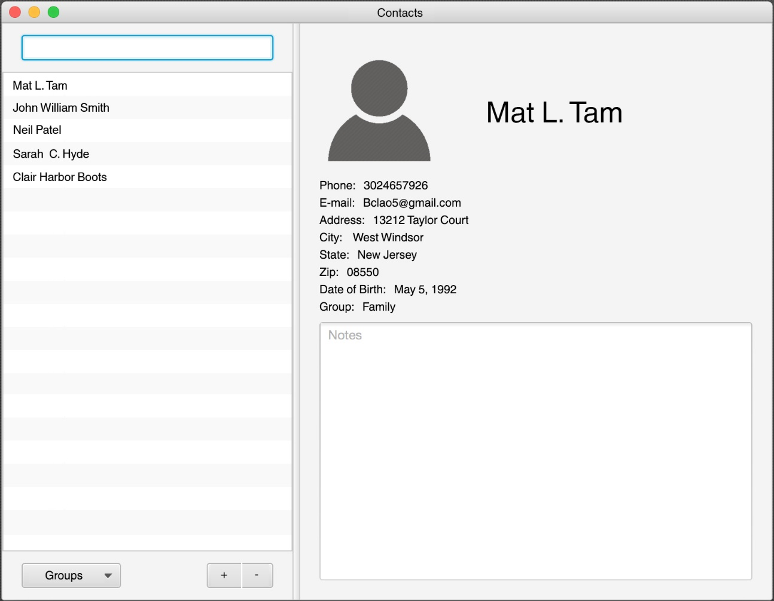
Contact
Search:
User is able to search for a contact by either
First, middle, or last name.
Search engine will display similar names with the same letter.
View Contact Content Area
User is able to see
Contacts Full name
Image of Contact if user adds a photograph
The information that user choices to enter in
Notes:
User is able to make notes about a contact
Contact List:
User is able to see and categorize contacts by first, middle, or last name.
Groups:
User is able to categorize contacts by types
Add:
User is able to add a contact
Delete:
User selects a contact and is able to remove it
If the user is a guest or has an account. Both will have this contact view. A guest has a public contact view so anyone can add or delete contacts. User who has an account has its own contact. Each individual user will have its own contact.

Slide 8



Contact: Sorting Contact List
Sort by First name
Sort by Middle name
Sort by Last name

Slide 9
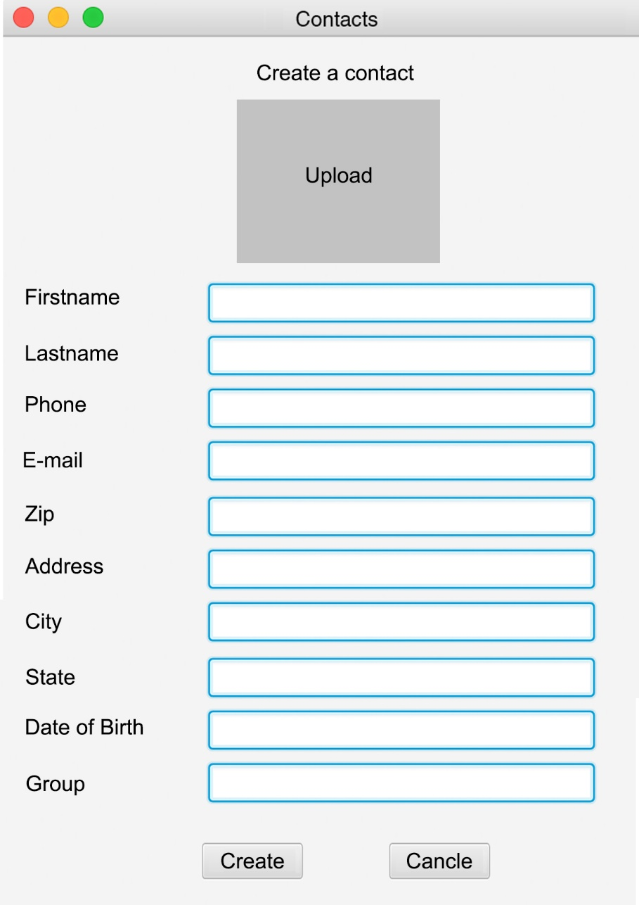
Contact: Adding a contact
User can upload a photo
When user adds an account, it has the option to complete the following fields.

Slide 10
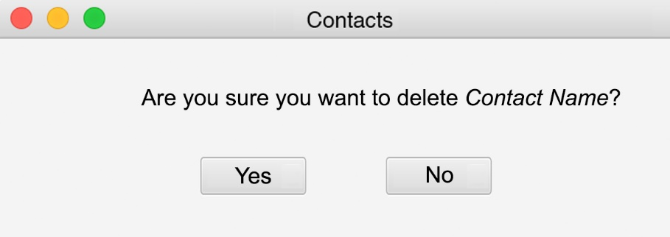
Contact: Removing a contact
When a user wants to remove a contact this window will appear.
It will prompt this message with the contact name that user wishes to delete

Slide 11
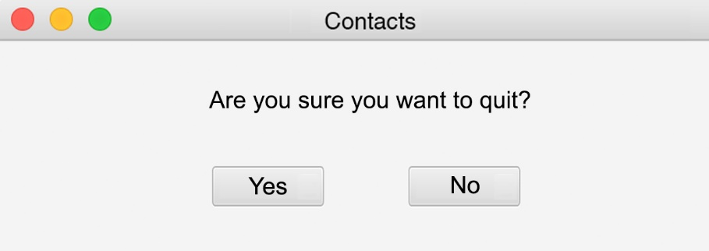
Closing
When user closes out the program

